Slide 1
Navigating AI Policy: Current Challenges, Future Directions
American Advertising Federation, September 25, 2025
Heather West
Senior Director of Cybersecurity and Privacy Services, Venable
Confidential

Slide 2
Definition of Artificial Intelligence (AI)
Artificial Intelligence (AI) is using computers to:
  Make decisions and predictions, answer questions, and solve problems using data.
  Complete tasks that require creativity or higher-order cognitive skills when done by humans.
An AI system is a machine-based system that is capable of influencing the environment by producing an output (predictions, recommendations or decisions) for a given set of objectives.
- Organisation for Economic Co-operation and Development (OECD)
An engineered or machine-based system that can, for a given set of objectives, generate outputs such as predictions, recommendations, or decisions influencing real or virtual environments. AI systems are designed to operate with varying levels of autonomy.
- National Institute of Standards and Technology (NIST)

Slide 3
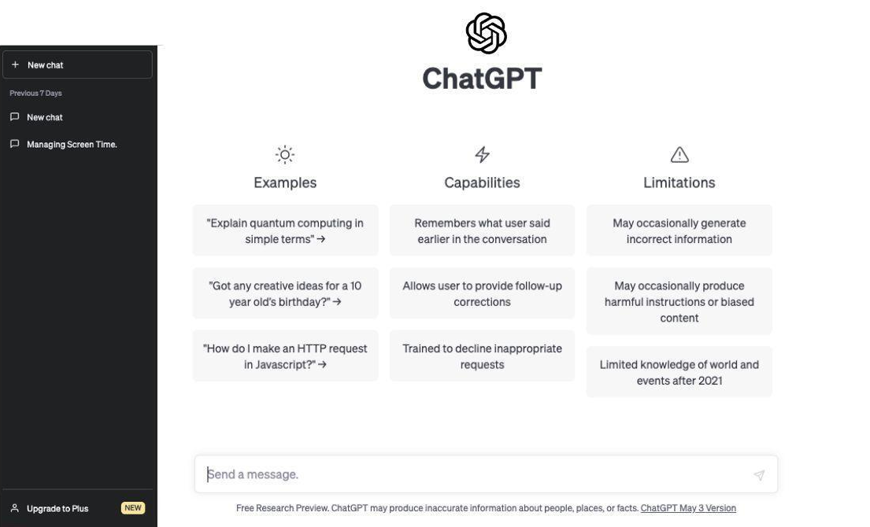

What’s Different for Generative AI
GenAI can answer questions, write or refine content, analyze data, write code, or create images or video.
GenAI tools are already widely used by individuals and organizations. Examples include:
  Chatbots: ChatGPT, Google Gemini, Microsoft Copilot
  Image generators: DALL•E 2, DreamStudio, Midjourney
  Video generators: Descript, Wondershare Filmora, Runway, Peech, InVideo
  Code assistants: GitHub Copilot, Amazon CodeWhisperer.
All of this leads to a new landscape for content.

Slide 4
AI Opportunities
Creativity: Unlock new ways of generating ideas, solutions, and content.
Efficiency: Automate repetitive or time-consuming tasks to free up human capacity.
Personalization: Adapt outputs and interactions to individual needs or contexts.
Insights: Identify patterns and trends in large datasets to support better choices.
Accessibility & Inclusion: Make advanced tools and resources available to a wider range of users.
Competitive Edge: Early adoption can differentiate organizations and set industry standards.

Slide 5
AI Risks: Data
Accuracy: AI systems can produce inaccurate or misleading outputs. Generative AI may “hallucinate” facts or embed bias, requiring continuous retraining on reliable data.
Fairness: AI may reflect or amplify historical or systemic biases in input data, leading to unfair outcomes—especially in decisions that directly affect individuals.
Privacy: AI systems process large volumes of personal data. Improper use or disclosure can trigger privacy law violations and data breach liabilities.
Trade Secrets: Uploading confidential or trade secret material into generative AI tools may compromise its protection, as some tools reuse input data for training or other purposes.

Slide 6
AI Risks: Legal & Compliance
Legal Privilege: Sharing privileged legal information with generative AI tools may waive attorney–client privilege, or otherwise compromise confidentiality, if data is exposed to third parties.
Intellectual Property & Copyright: Purely AI-generated content is generally not protected by copyright. Ownership is further complicated if training data or outputs incorporate unlicensed works.
Compliance: AI use may trigger sector-specific compliance requirements. Monitoring and auditability remain challenging, and shifting regulations create uncertainty.

Slide 7
AI Risks: Operational
Security: AI systems may be targeted by cyberattacks (e.g., data poisoning, breaches, or system compromises) or exploited to create new threats. Basic cybersecurity practices reduce—but do not eliminate—these risks.
Education: Employees may use AI tools without training on risks or adherence to acceptable use policies, creating organizational exposure.
Opportunity Cost: Avoiding AI altogether may create competitive disadvantages and new risks compared to peers who adopt.
Contractual: Increasing scrutiny of AI-assisted work product and limitations on the kinds of tools used.

Slide 8
Federal

Slide 9
Congressional Themes For 2025
AI and Emerging Technology: Shift from exploratory discussions on AI ethics and competitiveness to active development of legislative frameworks for AI governance, risk mitigation, and election security.
Antitrust and Competition: New focus on platform accountability, interoperability, and data portability.
Cybersecurity and Infrastructure: Evolved from reactive responses to major cyber incidents toward a broader focus on cyber resilience, supply chain security, and AI-related vulnerabilities.
Content Governance and Online Harms: Adding to the broad debates over Section 230 with more specific concerns, such as child online safety, deepfakes, and liability for AI-generated content.
Data Privacy: Continued pursuit of comprehensive federal privacy legislation, with the 118th Congress starting “fresh” and evaluating state-level developments and algorithmic accountability concerns.
Geopolitics and Technology: Intensified focus on strategic technology competition, marked by implementation of the CHIPS Act, scrutiny of foreign-owned platforms, and expansion of export controls and sanctions.

Slide 10
Congressional Action
TAKE IT DOWN Act (passed): Deepfake legislation to prohibit the nonconsensual disclosure of AI-generated intimate imagery and require platforms to remove such content published on the platform.
AI Moratorium: Republicans attempted to include a ten-year ban on state AI laws and regulation within the budget reconciliation bill. The proposal received significant pushback from various constituencies, and the proposal fell apart – but the idea is resurfacing in many proposals.
CREATE AI Act: Establishes a National Artificial Intelligence Research Resource (NAIRR) to provide shared computing and data infrastructure for U.S. researchers. Designed to bolster domestic AI innovation and public-sector capacity.
No DeepSeek on Government Devices Act/No Adversarial AI Act: Prohibits the use of the Chinese AI apps, or apps from adversary countries, on federal devices due to national security concerns. Reflects growing bipartisan efforts to limit foreign AI influence on critical infrastructure.
SANDBOX Act: Establishes a “regulatory sandbox” to allow AI developers to seek temporary waivers or modifications of existing rules that might hinder innovation.

Slide 11
Shift in Priorities
The Biden administration emphasized ethical considerations, safety, and regulatory measures in AI development. The Trump administration has shifted focus toward deregulation, fostering innovation through private sector partnerships, and reinforcing national security by controlling AI technology exports.
Biden Administration | Trump Administration
Emphasis on safety and ethics, social impact | Private sector collaboration and leadership
National security focus on democratic values | National security focus on export controls and export to allies
Decentralized implementation of rules and guardrails | Deregulatory focus and promotion of innovation

Slide 12
Winning the Race: America’s AI Action Plan
White House roadmap to advance U.S. leadership in AI, focused on federal adoption, American infrastructure, and international dissemination.
Issued pursuant to Executive Order 14179 (Removing Barriers to American Leadership in Artificial Intelligence), which rescinded prior regulatory frameworks and directed the creation of a new AI strategy.
Goal to establish U.S. global leadership and technological dominance in AI, emphasizing deregulation and competitive advantage.
Three pillars:
Accelerating AI Innovation | Emphasizes reducing regulatory barriers, simplifying agency AI adoption, promoting open-weight models, and ensuring AI systems remain ideologically neutral and truth-seeking.
Building American AI Infrastructure | Focuses on streamlining permitting for data centers and semiconductor manufacturing, expanding energy and grid capacity, deploying secure U.S. AI infrastructure, and workforce development.
Leading International AI Diplomacy & Security | Includes exporting a full American AI tech stack to allies, enforcing export controls, countering adversarial influence (notably from China), and coordinating global AI governance aligned with U.S. standards.

Slide 13
The AI Action Plan
Explicit deregulatory focus, with an upcoming RFI from the Office of Science and Technology Policy to gather information about federal regulations that are “hindering AI innovation and adoption.”
Encouragement of public and private sector adoption of AI, and an emphasis on open source and open weight models.
Direction not to fund state projects or to give grants if there is burdensome AI regulation in place and evaluate whether state AI laws and rules interfere with federal authorities.
FTC review of all Biden administration AI-related investigations, orders, and injunctions to ensure theories of liability do not burden AI innovation. It is unclear whether this will include Operation AI Comply, or whether claims about AI are part of this review.
Review of workforce readiness and training needs.
A focus on ideological neutrality of generative AI models, including a companion Executive Order around federal procurement.

Slide 14
Notably Absent: Copyright and Content Provenance
During AI Action Plan launch, President Trump stated there should be a “common-sense application of artificial and intellectual property rules”; stating that “licensing everything” is “just not doable” and noting that “China is not doing it” - but no established policy.
AI Action Plan: Intentionally silent on copyright policy issues, with leadership noting a preference to let the courts determine.
Copyright Office: 2024-25 reports on AI topics, however leadership changes create ambiguity.
Focus on the Courts: Copyright and licensing disputes over training data and AI-generated outputs, platforms shifting liability for generative outputs.
    Dozens of ongoing litigation related to training AI models and whether the use of copyrighted content is an infringement or defensible as a “fair use”; individual parties as well as class actions.
    Copyright for AI outputs only if there is significant human authorship.
  Content Provenance: Industry action, but little federal action.

Slide 15
Existing State Law

Slide 16
Existing State Laws: Colorado
Colorado AI Act (SB 24-205, 2024): Largely Applicable to High-Risk AI and Algorithmic Discrimination. Requirements for developers and deployers of “high-risk AI systems,” defined to include AI systems that, when deployed, make or are a “substantial factor” in making a “consequential decision.” Developers and deployers are required to take certain steps to document and protect against reasonably foreseeable risks of “algorithmic discrimination,” as well as provide certain notices and individual rights. Disclosure required for AI systems, unless it is “obvious.” AG enforcement.

Slide 17
Existing State Laws: California
California Generative Artificial Intelligence Training Data Transparency Act (AB 2013, 2024): Requires developers of generative AI to post documentation about training data, including sources or owners of the datasets, types of data labels used, whether datasets include any data protected by IP law or if datasets are in the public domain, whether datasets were purchased or licensed by the developer, and whether the datasets include “personal information,” as defined by CCPA. Training, as defined, includes testing, validating, or fine tuning by the developer of the AI system or service.
California AI Transparency Act (SB 942, 2024): Requires generative AI providers to use watermarks (“manifest disclosure”), make available an AI detection tool, and include language in licenses to retain watermarking capability.
CCPA PI Definition Includes Data in AI Systems (AB 1008, 2024): Clarifies PI can exist in various formats, including abstract digital formats, including compressed or encrypted files, metadata, or AI systems that are capable of outputting personal information.

Slide 18
Existing State Laws: California
CPPA Proposed ADMT Regulations: Provides pre-use notice and opt out requirements for use of PI to train ADMT for certain uses – identifying people; physical or biological identification or profiling, which is defined broadly in CA; making significant decisions.
Additional Issue-Specific AI Bills. See California Attorney General’s Legal Advisory on the Application of Existing California Laws to Artificial Intelligence.
Joint California Policy Working Group on AI Frontier Models. The Working Group announced that it published its draft report on AI frontier models following a 2024 request from Governor Newsom. The draft report: (1) offers a framework for policymaking on frontier AI; (2) recognizes the importance of safeguarding innovation and creating appropriate strategies to mitigate “material risks”; and (3) considers AI research from multiple disciplines to generate policy principles to inform California’s approach to use, assess, and govern frontier AI. The final report was published in June 2025.

Slide 19
Existing State Laws: Texas
Texas Responsible Artificial Intelligence Governance Act (2026): Regulates mostly government use of AI but has some general application - prohibits any person from developing or deploying an AI system that intentionally and harmfully manipulates human behavior, with the intent to infringe individual's rights or unlawfully discriminate, or to produce or distribute sexually explicit content.
Texas Data Privacy and Security Act (2024): Provides consumers the right to opt-out of any form of solely automated processing on personal data to make legal or similarly significant decisions based on certain attributes. Requires a data protection assessment of each processing activity involving such automated processing of personal data.

Slide 20
Existing State Laws: Utah
Utah Artificial Intelligence Policy Act. (SB 149, 2024, amended 2025): Requires clear and conspicuous disclosure that a consumer is interacting with Gen AI (rather than a human) if asked by the consumer during “high-risk” AI interactions. A “high-risk” AI interaction is defined as an interaction involving the collection of “sensitive personal information” such as financial, health or biometric data; and the provision of personalized recommendations or advice “that could reasonably be relied upon to make significant personal decisions,” including the provision of financial, legal, medical or mental health advice. Enforcement safe harbor where there is clear and conspicuous disclosure that the consumer is interacting with Gen AI.

Slide 21
2025 State Bills

Slide 22
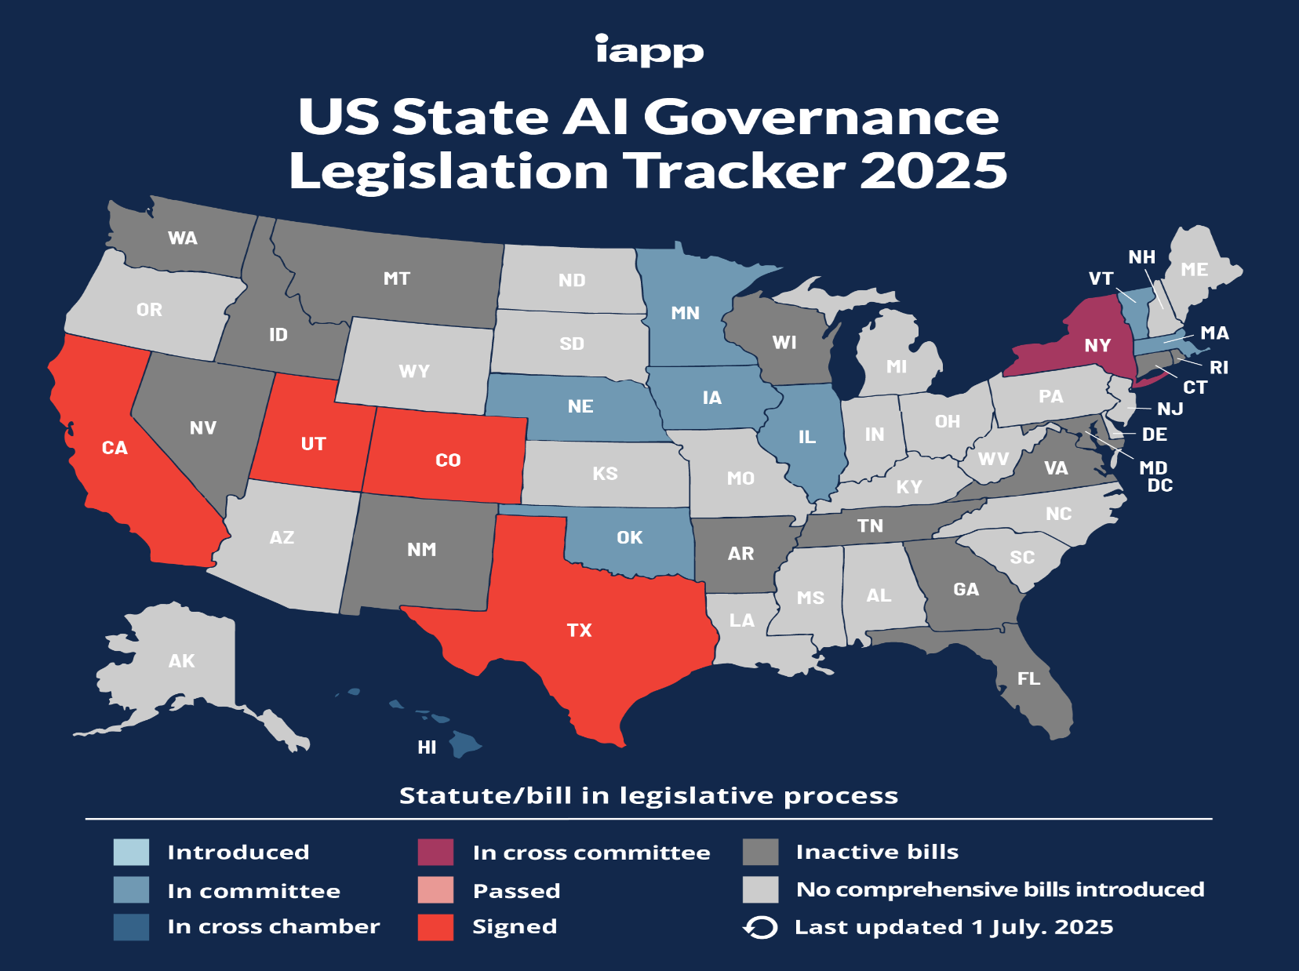
States Considering AI Legislation in 2025
© 2025 / Confidential / Slide 22

Slide 23
Theme: Disclosures & Transparency
Hawaii HB 639: Requires notification when a consumer is interacting with an AI chatbot or other technology capable of mimicking human behaviors, with certain exemptions.
Idaho HB 127: Requires conversational AI or chatbots to disclose that communication is AI generated.
Massachusetts H. 81: Mandates that generative AI systems disclose AI-generated content on or within such content and include metadata identifying the system, creator, and creation date.
Washington HB 1168: Requires a developer to provide public documentation regarding data used to train generative AI system; similar to California AB 2013.
Washington HB 1170: Requires a provider to make available an AI detection tool; requires latent disclosures; provides options for manifest disclosures; similar to California SB 942.
Nevada SB 199: Requires AI companies to register with the Bureau of Consumer Protection, and to develop and implement policies and procedures to protect against bias, generation of hate speech, bullying, misinformation, and other listed risks.
New York AB 768: Largely like CO AI Act, with requirements for “general-purpose AI models” to make available technical documentation about training and testing, tasks the AI is to perform, acceptable use policies; disclosures to consumers who are interacting with broadly defined AI decision systems.

Slide 24
Theme: Consumer Rights & Prohibitions
California SB 420: Right to receive explanations of how AI systems operate, including the data they use and decisions they make; right to control personal data in AI systems; right to human oversight of the systems; accountability.
California SB 11: Systems producing synthetic content must have a consumer warning that misuse may result in civil or criminal liability for the user; liability for the use of likeness for advertising without consent.
Minnesota HF 2542: Prohibits the use of AI to dynamically set prices.
Texas HB 1709: Similar to CO AI Act, but would add a right to know if the consumer's personal data is or will be used in any AI system and why, and a right to opt out of the sale of personal data for use in AI systems. Would also add a privacy policy disclosure requirement related to AI; social scoring requirements; create a sandbox program; create the Texas Artificial Intelligence Council with regulatory authority; create the AI workforce development program to support and assist TX-based AI companies in developing a skilled workforce.

Slide 25
Theme: Minors Protections & New Agencies / Task Forces
California AB 1064: Creates the “LEAD for Kids Standards Board” to regulate AI and require developer of AI system intended or highly likely to be used by minors to register the product with the Board, prepare and submit a risk level assessment, and develop and implement an AI information label for the product.
Maine LD 230: Prohibits use or display in an advertisement a picture, image or likeness of a specific minor artificially generated by technology, including AI technology.)
Alaska HCR 3: Creates the Task Force on AI to examine the development, implementation, and regulation of AI in the state.

Slide 26
Theme: High-Risk AI
California AB 1018: Regulates the development and deployment of an automated decision system (ADS) used to make consequential decisions.
New York AB 768: Similar to CO AI Act.
Virginia HB 2094: Similar to CO AI Act.

Slide 27
What to Expect
Legislative Trajectory: Broad debates have given way to targeted legislation addressing specific use cases or creating experimental regulatory frameworks. Growing federal activity, but states are moving faster.
Administration Shifts: Unclear how aggressively agencies will pursue enforcement in AI-related areas.
All About the Data: Legal uncertainty for copyright and training data.
State-Level Fragmentation: States likely to remain highly active, and bills may set markers for other states, industry norms, federal action. Emerging state laws on deepfakes, disclosure, and content labeling and proposals around explanations, data use, and accountability. Fragmentation may be more pronounced than state privacy legislation.
Industry Norms: Expectations around authenticity, transparency, and provenance of AI-generated content are not yet clear, with industry self-regulation and norms being established.

